Slide 1
Historical Context of Reward Schools
Josh Carson & Evan Kramer | Data Governance and Accountability
Notes:
Evan

Slide 2
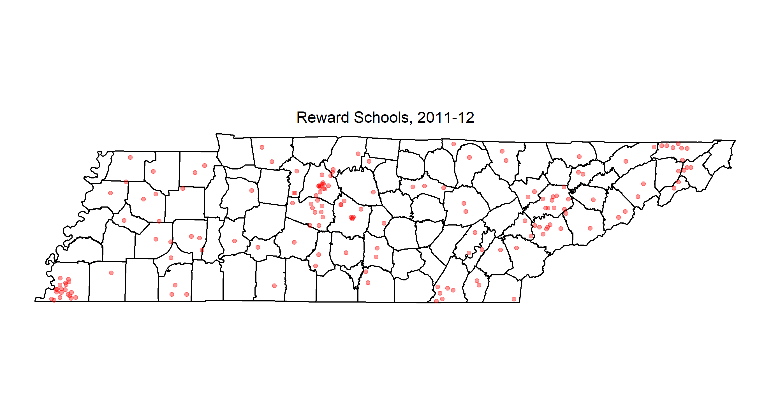
We identified 169 Reward schools in 2012.

Slide 3
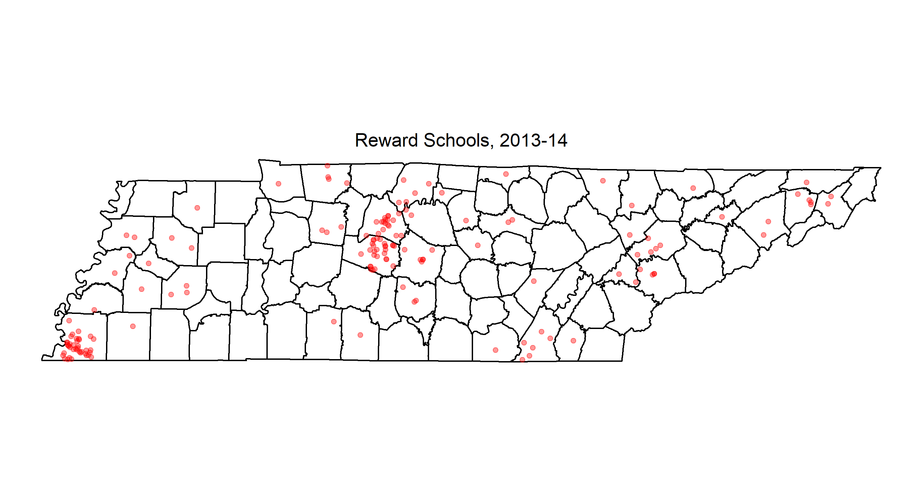
We identified 169 Reward schools in 2014.

Slide 4
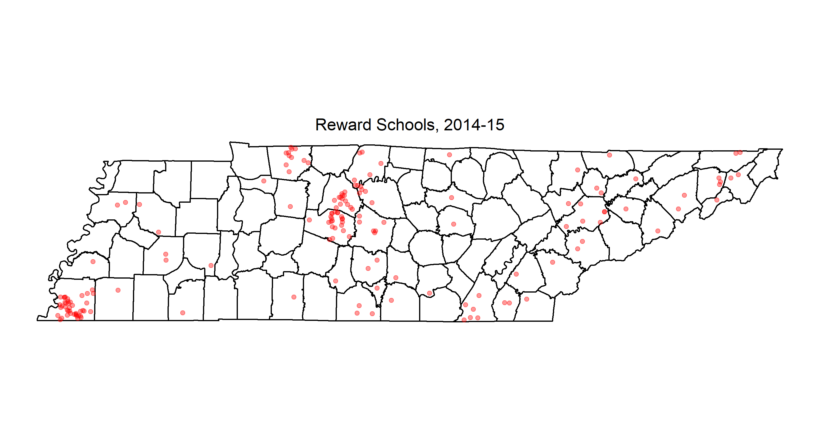
We identified 170 Reward schools in 2015.

Slide 5
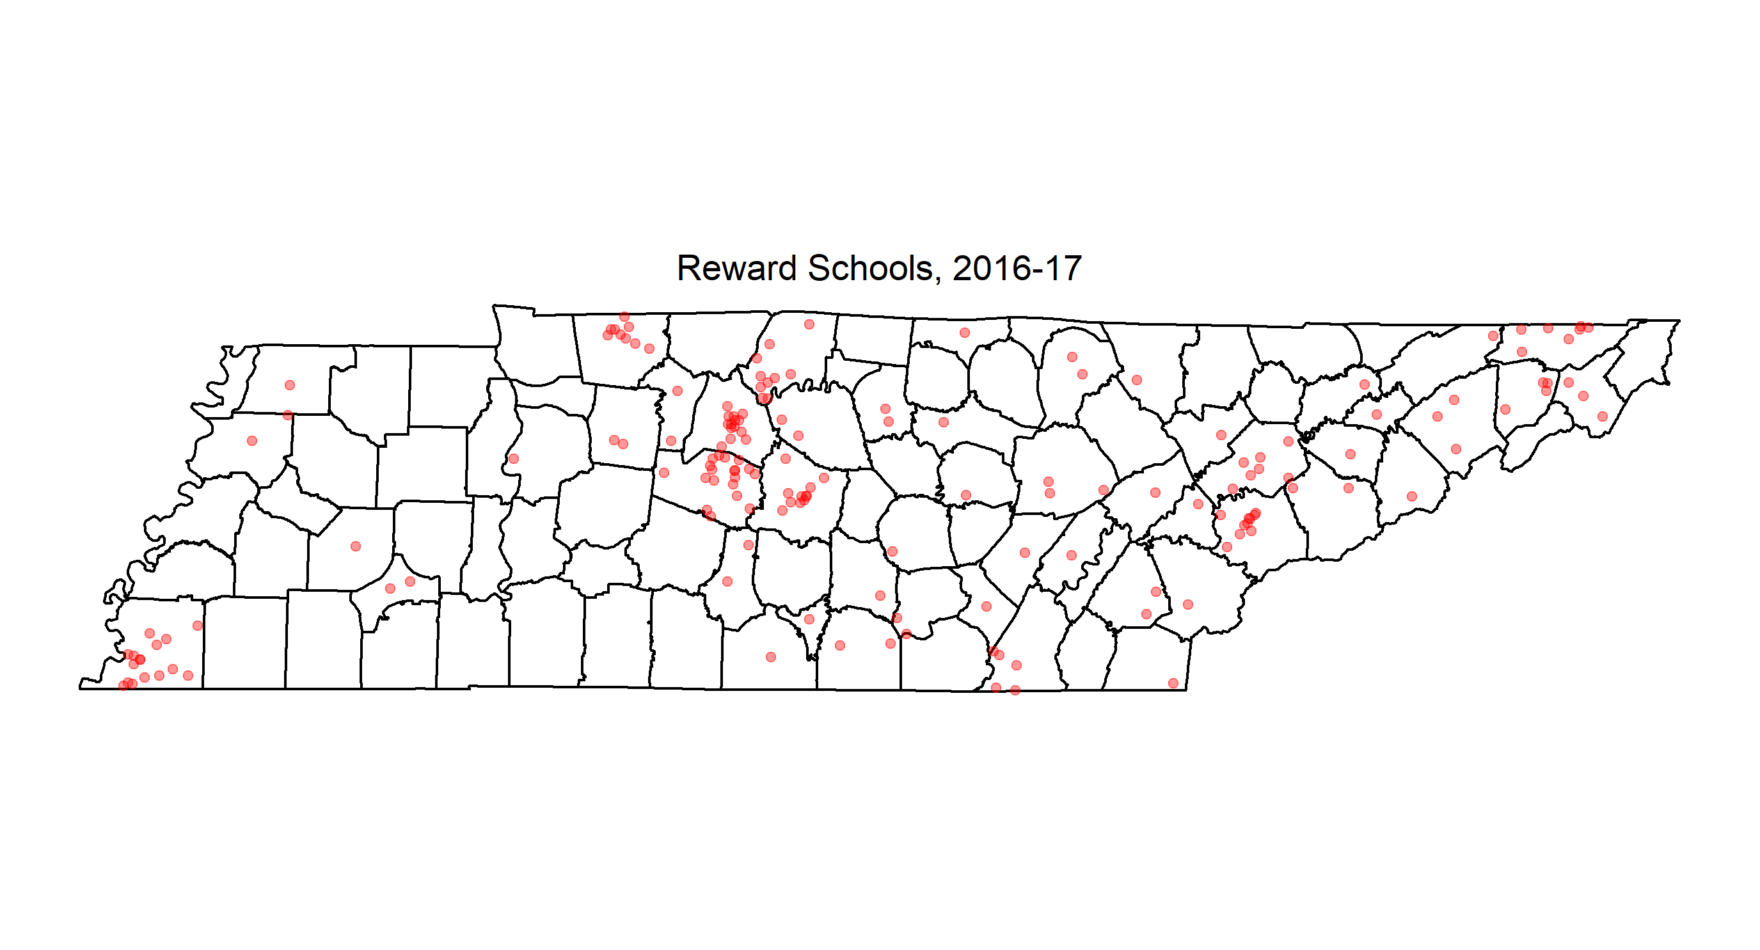
We identified 169 Reward schools in 2017.

Slide 6
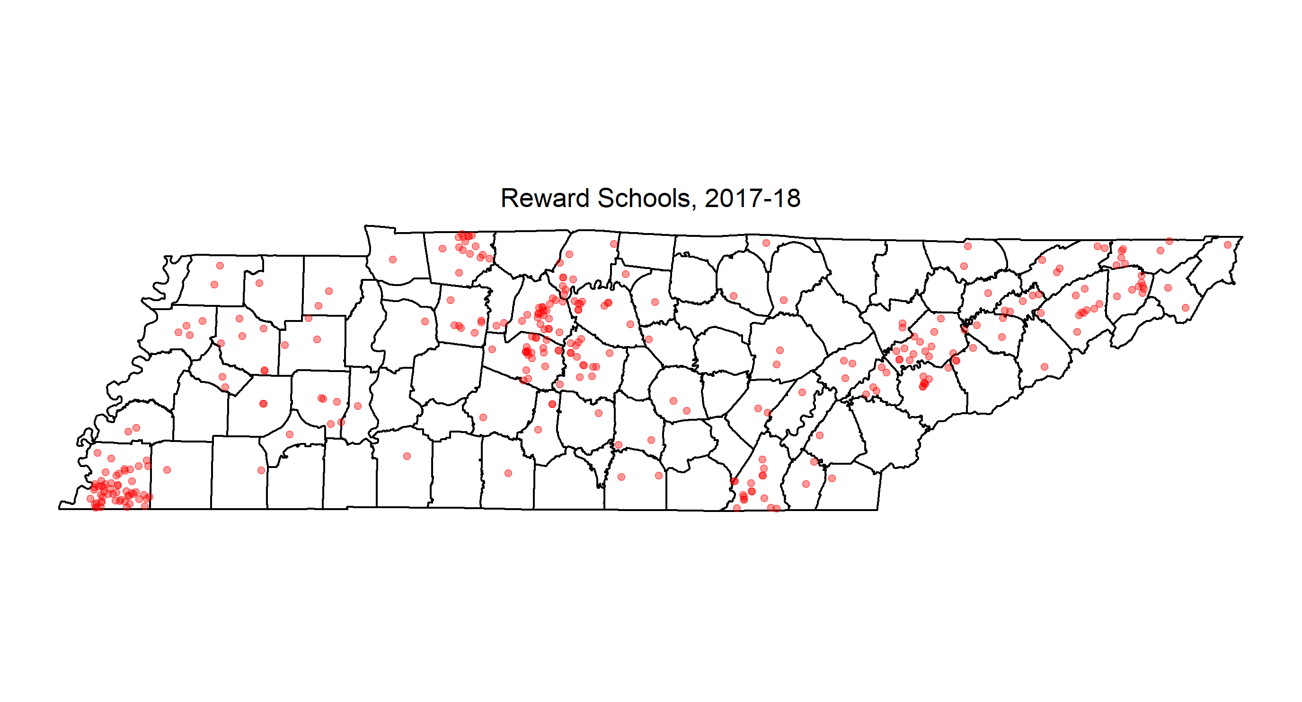
We identified 318 Priority schools in 2018, far more than ever before.

